Slide 1
Revelation 2:18-29

Slide 2
¹⁸ “And to the angel of the church in Thyatira write: ‘The words of the Son of God, who has eyes like a flame of fire, and whose feet are like burnished bronze.
¹⁹ “ ‘I know your works, your love and faith and service and patient endurance, and that your latter works exceed the first. ²⁰ But I have this against you, that you tolerate that woman Jezebel, who calls herself a prophetess and is teaching and seducing my servants to practice sexual immorality and to eat food sacrificed to idols. ²¹ I gave her time to repent, but she refuses to repent of her sexual immorality. ²² Behold, I will throw her onto a sickbed, and those who commit adultery with her I will throw into great tribulation, unless they repent of her works, ²³ and I will strike her children dead.

Slide 3
And all the churches will know that I am he who searches mind and heart, and I will give to each of you according to your works. ²⁴ But to the rest of you in Thyatira, who do not hold this teaching, who have not learned what some call the deep things of Satan, to you I say, I do not lay on you any other burden. ²⁵ Only hold fast what you have until I come. ²⁶ The one who conquers and who keeps my works until the end, to him I will give authority over the nations, ²⁷ and he will rule them with a rod of iron, as when earthen pots are broken in pieces, even as I myself have received authority from my Father. ²⁸ And I will give him the morning star. ²⁹ He who has an ear, let him hear what the Spirit says to the churches.’

Slide 4
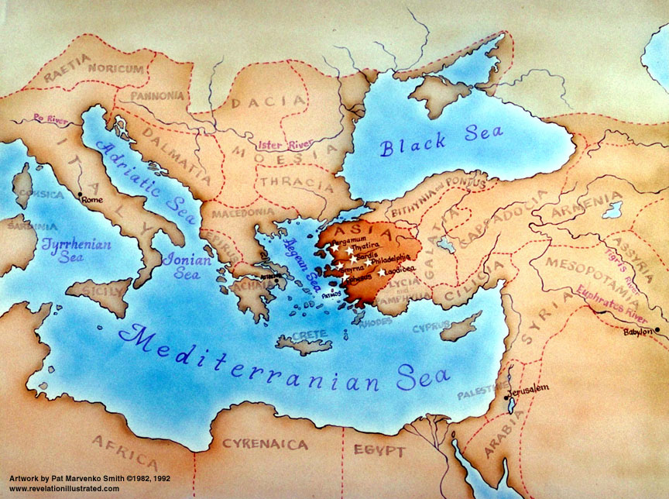
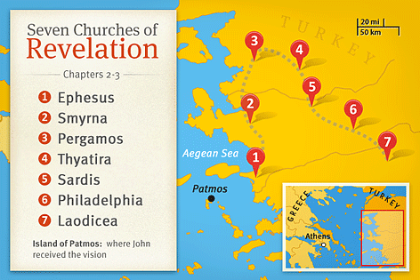

Slide 5
The Church at Thyatira
Powerful Trade Guilds made it almost impossible to earn a living without being a member.
Trade Guild dinners were idolatrous and immoral affairs and Christians were being drawn in to them
Jesus describes Himself:
The Son of God (linked to Psalm 2)
Eyes of fire (Sees everything – nothing escapes His judgment)
Feet like burnished bronze (holiness to trample the ungodly)
Jesus sees good in the church:
Love; Faith; Service; Patient endurance;
“Your latter works exceed the first”
Not a bunch of ‘stodgy’ Christians
Jesus sees the bad in the church:
²⁰ But I have this against you, that you tolerate that woman Jezebel, who calls herself a prophetess and is teaching and seducing my servants to practice sexual immorality and to eat food sacrificed to idols. ²¹ I gave her time to repent, but she refuses to repent of her sexual immorality.

Slide 6
Jesus sees the bad in the church:
²⁰ But I have this against you, that you tolerate that woman Jezebel, who calls herself a prophetess and is teaching and seducing my servants to practice sexual immorality and to eat food sacrificed to idols. ²¹ I gave her time to repent, but she refuses to repent of her sexual immorality.
A prophetic word from God will never be in conflict with His written Word.
Jezebel is shown to be a false prophetess
The whole church should test the words of a prophet to determine if what they are saying is from God or not.
Jezebel – proverbial name to represent evil. Married to King Ahab & turned Israel to worship Baal & do evil.
In Thyatira, a false prophetess, leading God’s people into idolatry and sexual immorality

Slide 7
A prophetic word from God will never be in conflict with His written Word.
Jezebel is shown to be a false prophetess
The whole church should test the words of a prophet to determine if what they are saying is from God or not.
Jezebel – proverbial name to represent evil. Married to King Ahab & turned Israel to worship Baal & do evil.
In Thyatira, a false prophetess, leading God’s people into idolatry and sexual immorality
Deception of a false prophet
Tell us what our ‘itching ears’ want to hear
Claim to teach us ‘deeper’ things of God
Introduce other sources of wisdom and authority
E.g. “progressive theology” “Liberal theology”.
Often leads to a ‘loose’ sexual ethic & often an acceptance of other Gods (universalism)

Slide 8
Deception of a false prophet
Tell us what our ‘itching ears’ want to hear
Claim to teach us ‘deeper’ things of God
Introduce other sources of wisdom and authority
E.g. “progressive theology” “Liberal theology”.
Often leads to a ‘loose’ sexual ethic & often an acceptance of other Gods (universalism)
Jezebel had already been warned – now it’s time for judgment
²¹ I gave her time to repent, but she refuses to repent of her sexual immorality. ²² Behold, I will throw her onto a sickbed, and those who commit adultery with her I will throw into great tribulation, unless they repent of her works, ²³ and I will strike her children dead. And all the churches will know that I am he who searches mind and heart, and I will give to each of you according to your works.

Slide 9
²⁵ Only hold fast what you have until I come. ²⁶ The one who conquers and who keeps my works until the end, to him I will give authority over the nations, ²⁷ and he will rule them with a rod of iron, as when earthen pots are broken in pieces, even as I myself have received authority from my Father. ²⁸ And I will give him the morning star. ²⁹ He who has an ear, let him hear what the Spirit says to the churches.’
Those who remain faithful / or Who repent:
Jesus, the just, merciful, righteous King will rule with all authority
The faithful will rule with Him
Jesus is the Son of God. The Faithful become sons of God
The faithful are given “the morning star” (Jesus) – eternally in His glorious presence.

